Slide 1
Car Price Prediction Model
Based on Real Life Problem of car sales, Models predicts the car price on the basis of different inputs such as brand, engine volume etc. It involves the following
Model: Multivariable Linear Regression
Data Cleaning
Data visualisation
Taking Assumptions
Log Transformation
Creation of dummies
Creation of a model
Project By:
Chaman Patel
21121017

Slide 2
Background:
The automotive industry is highly competitive, with car prices being influenced by a multitude of factors. Accurate car price predictions can significantly benefit various stakeholders, including manufacturers, dealers, and buyers. By leveraging historical data, we aim to build a predictive model that can estimate the price of a car based on key attributes.
Objective:
The objective of this project is to develop a data science model that can predict car prices using the provided dataset. The model will help in understanding the relationship between various features and the car prices, ultimately aiding in making informed pricing decisions.
Problem Statement:
Create a predictive model to estimate the price of a car based on the provided dataset. The dataset includes various features that potentially influence car prices.

Slide 3
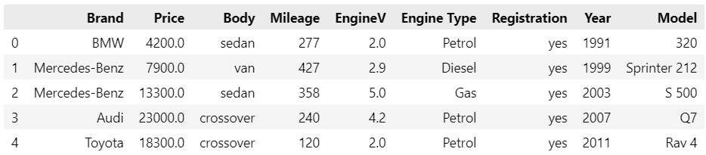
Data Exploration:
Data Preview
Code:
raw_data = pd.read_csv('1.04. Real-life example.csv')
raw_data.head()

Slide 4
Description of the Dataset
The provided dataset contains information about various cars and their attributes, which can be used to predict car prices. Here’s a detailed description of the dataset:
Dataset Overview
Total Entries: 4345
Total Columns: 9
Columns and Data Types
Brand (object): The manufacturer of the car (e.g., BMW, Mercedes-Benz, Audi).
Price (float64): The price of the car. Note that there are some missing values (4173 non-null entries).
Body (object): The body type of the car (e.g., sedan, van, crossover).
Mileage (int64): The total distance the car has been driven, in kilometers.
EngineV (float64): The volume of the car's engine in liters. There are some missing values (4195 non-null entries).
Engine Type (object): The type of engine (e.g., Petrol, Diesel, Gas).
Registration (object): Whether the car is registered or not (yes or no).
Year (int64): The year the car was manufactured.
Model (object): The specific model of the car.

Slide 5
Data Summary
Brand: This categorical feature indicates the car manufacturer. Examples include BMW, Mercedes-Benz, and Audi.
Price: This is the target variable representing the car's price. Some values are missing and need to be addressed.
Body: This categorical feature indicates the body type of the car. Examples include sedan, van, and crossover.
Mileage: This numeric feature represents the car's mileage in kilometers.
EngineV: This numeric feature represents the engine volume in liters. Some values are missing and need to be addressed.
Engine Type: This categorical feature indicates the type of engine, such as Petrol, Diesel, or Gas.
Registration: This binary categorical feature indicates whether the car is registered (yes or no).
Year: This numeric feature represents the manufacturing year of the car.
Model: This categorical feature represents the specific model of the car.

Slide 6
Python libraries and their purpose in project
NumPy: Numerical Operations such as for calculating log and exponential etc.
Pandas: Dataset retrieval, creation and manipulation
Statsmodel: Check for multicollinearity by variance inflation factor (VIF)
Matplotlib: Outliers detection and data Visualization
SkLearn: Model Creation (Multivariable Linear Regression)
Seaborn: Betterment of the visualized data

Slide 7
Importing the relevant libraries
code:
import numpy as np
import pandas as pd
import statsmodels.api as sm
import matplotlib.pyplot as plt
from sklearn.linear_model import LinearRegression
import seaborn as sns
sns.set()

Slide 8
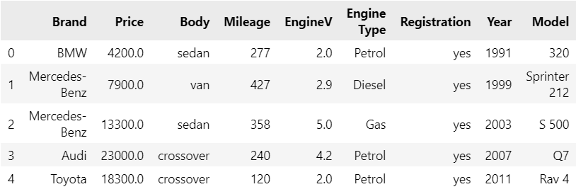
Loading Data
raw_data = pd.read_csv('1.04. Real-life example.csv')
raw_data.head()

Slide 9
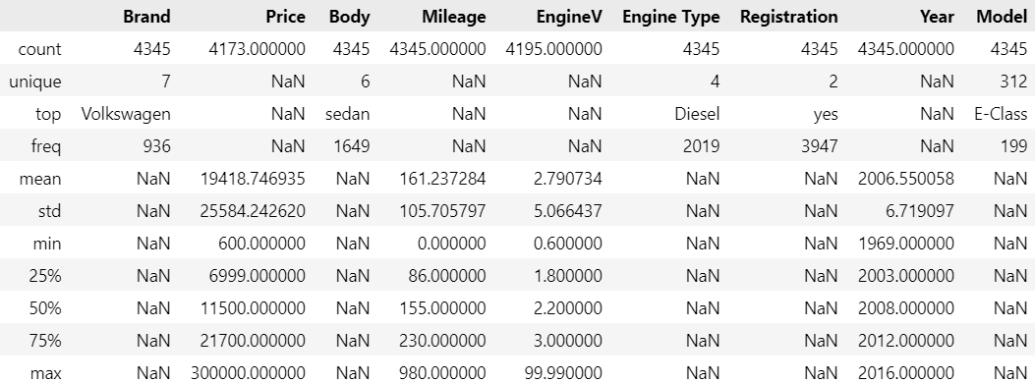
Preprocessing
Exploration of Descriptive Statistics of the variable
Code: raw_data.describe(include='all')
Note: Categorical variables don't have some types of numerical descriptives and numerical variables don't have some types of categorical descriptives.

Slide 10
Outcomes on analysing descriptive statistics
4345 number of rows in model column may have lots of unique model require lots of input columns for dummy. I decided to drop it as it will not impact my model much.
There is missing values in Price and EngineV column.
I will be dealing with it by dropping the rows with missing values. Since, the rule of thumb says that dropping nearly 5% of data will effect none and it’s completely ok.

Slide 11
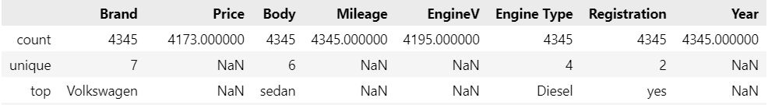
Determining the variable of interest
Data Cleaning
I have dropped column model because it require large number of dummy variable for each model there will be 1 column.
Code:
data = raw_data.drop(['Model'],axis=1)
data.describe(include='all')

Slide 12
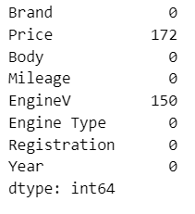
Dealing with missing values
data.isnull() shows a df with the information whether a data point is null. Since True = the data point is missing, while False = the data point is not missing, we can sum them. This will give us the total number of missing values feature-wise
Code: data.isnull().sum()

Slide 13
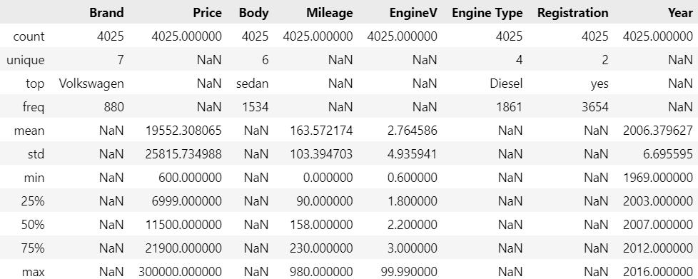
Descriptive without missing values

Slide 14
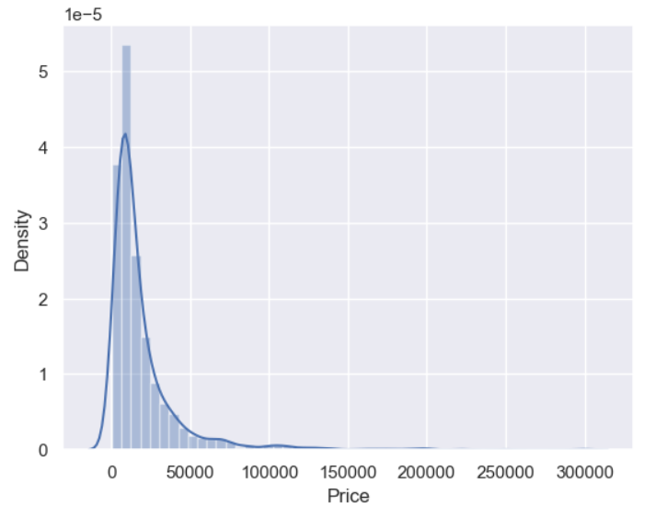
Plotting Probability Distribution Function (PDF)
Purpose:
The PDF will show us how that variable is distributed.
This makes it very easy to spot anomalies, such as outliers.
The PDF is often the basis on which we decide whether we want to transform a feature.
Outliers
Code:
sns.distplot(data_no_mv['Price'])
Here, the outliers are situated around the higher prices (right side of the graph)
Logic should also be applied
This is a dataset about used cars, therefore one can imagine how $300,000 is an excessive price

Slide 15
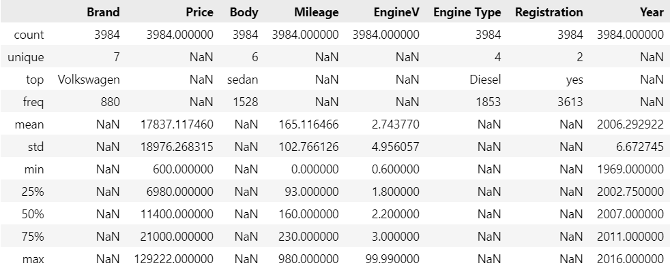
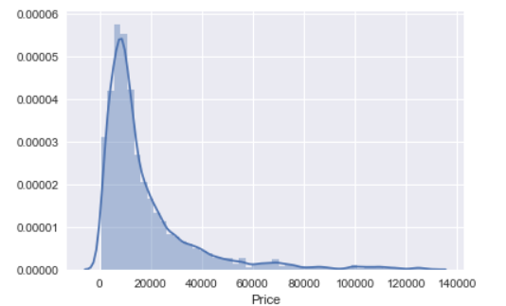
Dealing with outliers
We will only take values of price below 99 percentile.
Quantile method of Pandas will help to deal get value of 99 percentile.
Removed Outliers
Code:
q = data_no_mv['Price'].quantile(0.99)
data_1 = data_no_mv[data_no_mv['Price']<q]
data_1.describe(include='all')
Code: sns.distplot(data_1['Price'])

Slide 16
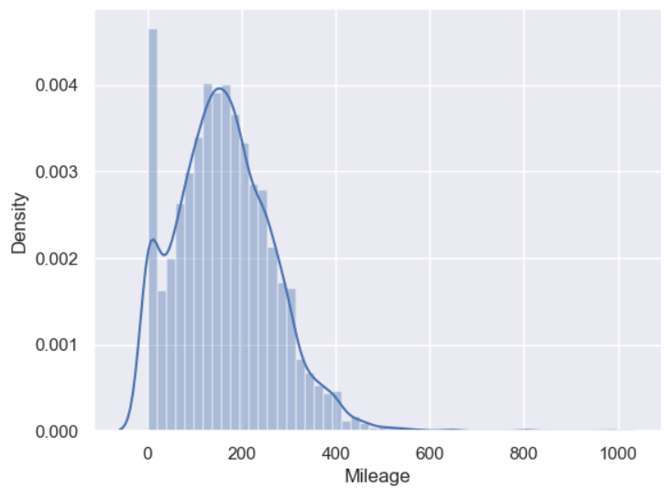
Checking for other variable
Mileage
Code: sns.distplot(data_no_mv['Mileage'])
This Outliers will affect the variable weight. Since, we want to remove this outliers because we want our model for majority of the population. Therefore, we want maximum occurrences.
Outliers

Slide 17
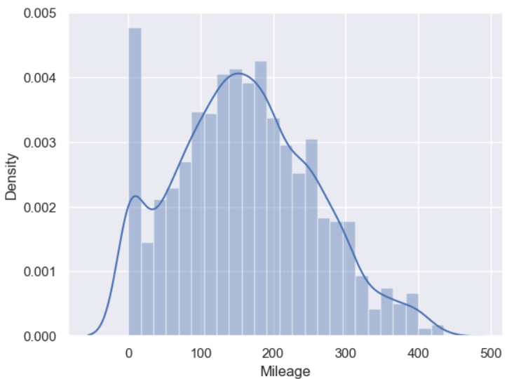
Dealing with it
Taking 99 Percentile of the mileage data
Code:
q = data_1['Mileage'].quantile(0.99)
data_2 = data_1[data_1['Mileage']<q]
sns.distplot(data_2['Mileage'])

Slide 18
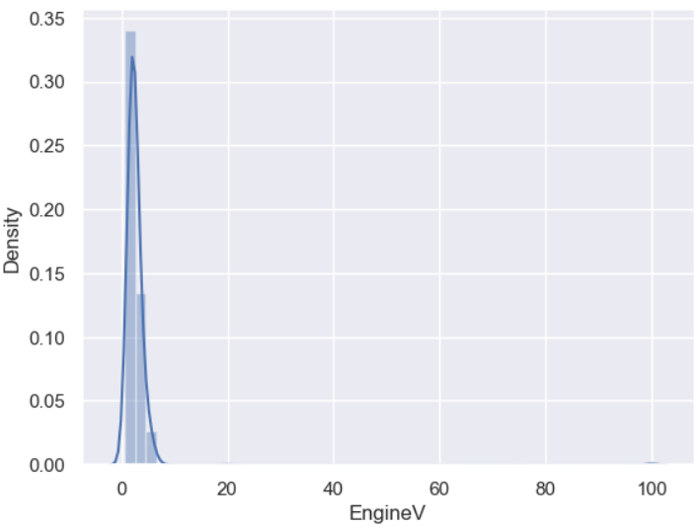
Engine Volume
Code: sns.distplot(data_no_mv['EngineV'])
OBSERVATION
The situation with engine volume is very strange.
In such cases it makes sense to manually check what may be causing the problem.
In our case the issue comes from the fact that most missing values are indicated with 99.99 or 99.
There are also some incorrect entries like 75.

Slide 19
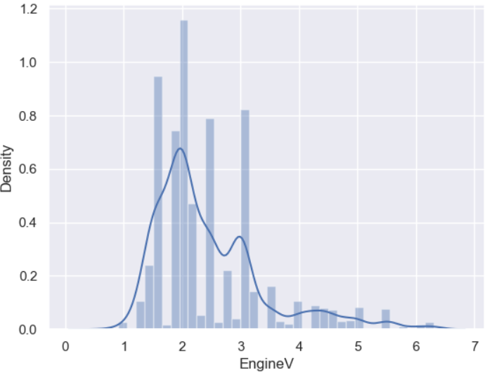
Dealing With incorrect entries in EngineV
Fact
A simple Google search can indicate the natural domain of this variable
Car engine volumes are usually (always?) below 6.5l
This is a prime example of the fact that a domain expert (a person working in the car industry)
may find it much easier to determine problems with the data than an outsider
Code:
data_3 = data_2[data_2['EngineV']<6.5]
sns.distplot(data_3['EngineV'])

Slide 20
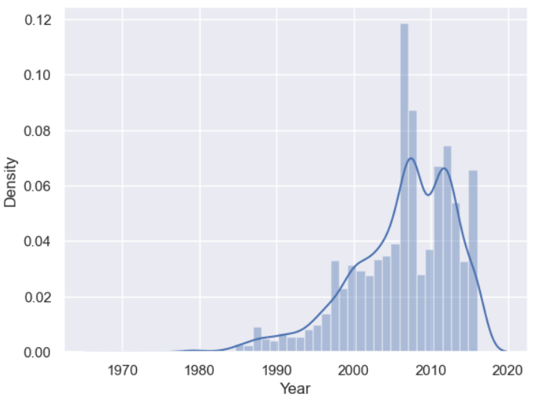
Year
Code: sns.distplot(data_no_mv['Year'])
Observation
the situation with 'Year' is similar to 'Price' and 'Mileage'.
However, the outliers are on the low end.
Outliers

Slide 21
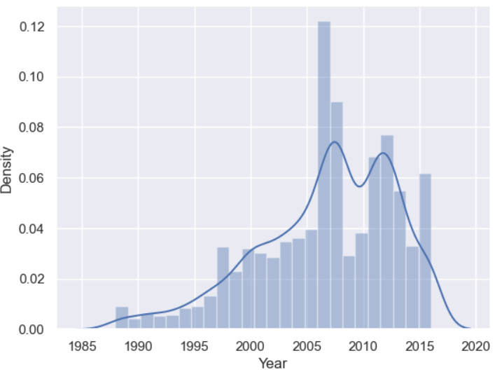
Dealing with year
Code:
q = data_3['Year'].quantile(0.01)
data_4 = data_3[data_3['Year']>q]

Slide 22
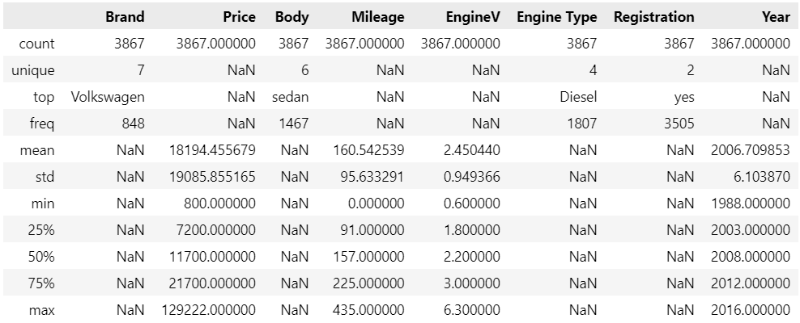
Descriptive of Cleaned Data
Code: data_cleaned.describe(include='all')

Slide 23
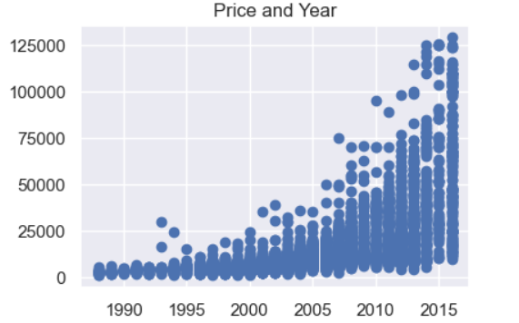
Checking OLS Assumption
Scatter plot can help
Code:
f, (ax1, ax2, ax3) = plt.subplots(1, 3, sharey=True, figsize =(15,3)) #sharey -> share 'Price' as y
ax1.scatter(data_cleaned['Year'],data_cleaned['Price'])
ax1.set_title('Price and Year')
ax2.scatter(data_cleaned['EngineV'],data_cleaned['Price'])
ax2.set_title('Price and EngineV')
ax3.scatter(data_cleaned['Mileage'],data_cleaned['Price'])
ax3.set_title('Price and Mileage')
plt.show()

Slide 24
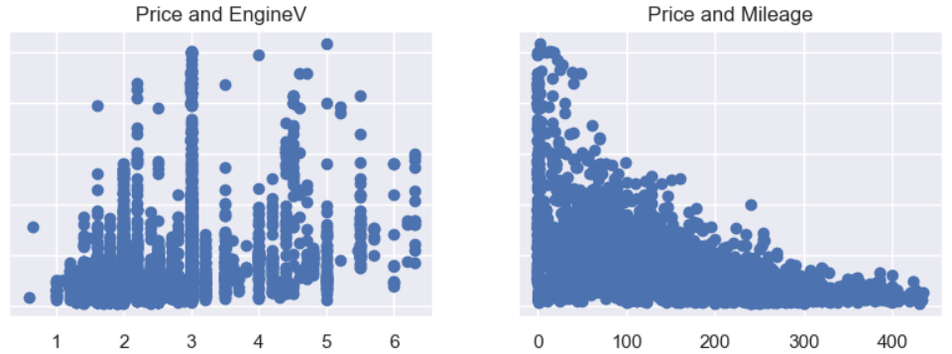
Observation:
Year and Mileage are exponentially dependent on Price.
Since, we need linear distribution we will take log Transformation of Price.
Linear regression requires linear dependence of variables

Slide 25
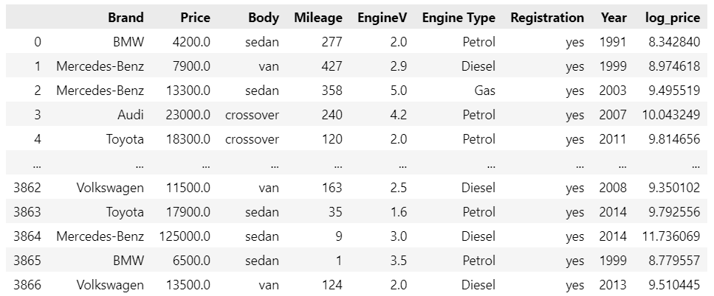
Transformations
Code:
log_price = np.log(data_cleaned['Price'])
data_cleaned['log_price'] = log_price
data_cleaned

Slide 26
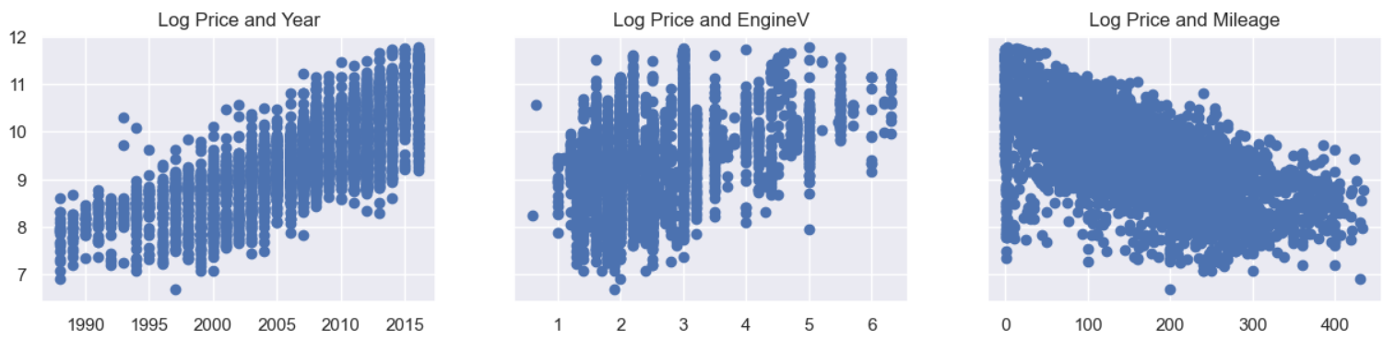
Scatter plot after Transformation
Code:
f, (ax1, ax2, ax3) = plt.subplots(1, 3, sharey=True, figsize =(15,3))
ax1.scatter(data_cleaned['Year'],data_cleaned['log_price'])
ax1.set_title('Log Price and Year')
ax2.scatter(data_cleaned['EngineV'],data_cleaned['log_price'])
ax2.set_title('Log Price and EngineV')
ax3.scatter(data_cleaned['Mileage'],data_cleaned['log_price'])
ax3.set_title('Log Price and Mileage')
plt.show()
The relationships show a clear linear relationship.
This is some good linear regression material.

Slide 27
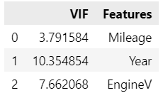
Multicollinearity
To make this as easy as possible to use, we declare a variable where we put.
All features where we want to check for multicollinearity.
Since our categorical data is not yet preprocessed, we will only take the numerical ones.
We create a new data frame which will include all the VIFs.
Note that each variable has its own variance inflation factor as this measure is variable specific (not model specific).
Here we make use of the variance_inflation_factor, which will basically output the respective VIFs.
Finally, I like to include names so it is easier to explore the result.
I will use stats model library to calculate VIF.
Code:
from statsmodels.stats.outliers_influence import variance_inflation_factor
variables = data_cleaned[['Mileage','Year','EngineV']]
vif = pd.DataFrame()
vif["VIF"] = [variance_inflation_factor(variables.values, i) for i in range(variables.shape[1])]
vif["Features"] = variables.columns
vif

Slide 28
Dealing with multicollinearity
Since Year has the highest VIF, I will remove it from the model.
This will drive the VIF of other variables down.
So even if EngineV seems with a high VIF, too, once 'Year' is gone that will no longer be the case.
Code:
data_no_multicollinearity = data_cleaned.drop(['Year'],axis=1)

Slide 29
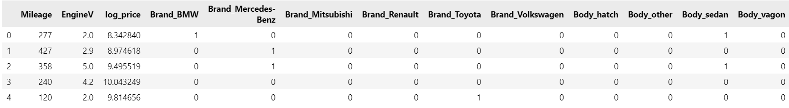
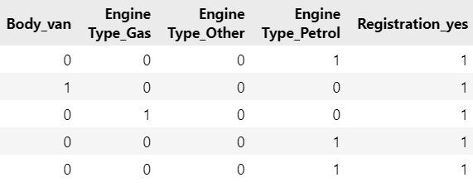
Create Dummy Variable
To include the categorical data in the regression, let's create dummies.
It is extremely important that we drop one of the dummies, alternatively we will introduce multicollinearity.
Code:
data_with_dummies = pd.get_dummies(data_no_multicollinearity, drop_first=True)
data_with_dummies.head()

Slide 30
Linear Regression Model
Declare inputs and target
The target(s) (dependent variable) is 'log price'.
The inputs are everything BUT the dependent variable, so we can simply drop it.
Code:
targets = data_preprocessed['log_price']
inputs = data_preprocessed.drop(['log_price'],axis=1)
Scaling of Data
Code:
from sklearn.preprocessing import StandardScaler
scaler = StandardScaler()
scaler.fit(inputs)
inputs_scaled = scaler.transform(inputs)

Slide 31
Train Test Split
Split the variables with an 80-20 split and some random state.
Code:
from sklearn.model_selection import train_test_split
x_train, x_test, y_train, y_test = train_test_split(inputs_scaled, targets, test_size=0.2, random_state=365)
Create the Regression
Code:
reg = LinearRegression()
reg.fit(x_train,y_train)
y_hat = reg.predict(x_train)

Slide 32
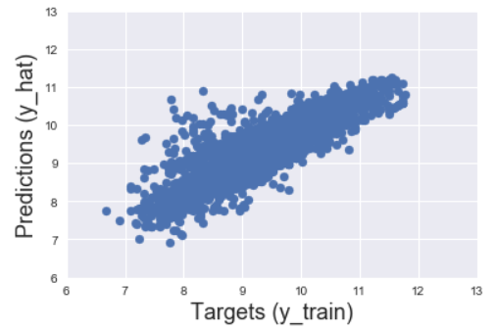
The simplest way to compare the targets (y_train) and the predictions (y_hat) is to plot them on a scatter plot.
The closer the points to the 45-degree line, the better the prediction.
Let's also name the axes.
Sometimes the plot will have different scales of the x-axis and the y-axis.
This is an issue as we won't be able to interpret the '45-degree line'.
We want the x-axis and the y-axis to be the same.
Code:
plt.scatter(y_train, y_hat)
plt.xlabel('Targets (y_train)',size=18)
plt.ylabel('Predictions (y_hat)',size=18)
plt.xlim(6,13)
plt.ylim(6,13)
plt.show()

Slide 33
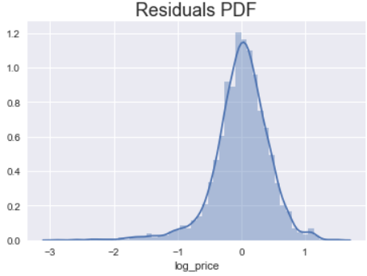
Another useful check of our model is a residual plot.
We can plot the PDF of the residuals and check for anomalies.
In the best case scenario this plot should be normally distributed.
In our case we notice that there are many negative residuals (far away from the mean).
Given the definition of the residuals (y_train - y_hat), negative values imply, that y_hat (predictions) are much higher than y_train (the targets).
This is food for thought to improve our model.
Code:
sns.distplot(y_train - y_hat)
plt.title("Residuals PDF", size=18)
Getting R^2 (Score)
Code: reg.score(x_train,y_train)
Output: 0.744996578792662

Slide 34
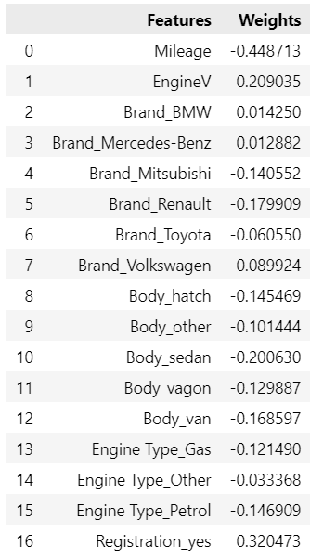
Finding Weights
Code:
reg_summary = pd.DataFrame(inputs.columns.values, columns=['Features'])
reg_summary['Weights'] = reg.coef_
reg_summary

Slide 35
Testing
Once we have trained and fine-tuned our model, we can proceed to testing it.
Testing is done on a dataset that the algorithm has never seen.
Luckily we have prepared such a dataset.
Our test inputs are 'x_test', while the outputs: 'y_test'.
We SHOULD NOT TRAIN THE MODEL ON THEM, we just feed them and find the predictions.
If the predictions are far off, we will know that our model overfitted.
Create a scatter plot with the test targets and the test predictions.
You can include the argument 'alpha' which will introduce opacity to the graph.

Slide 36
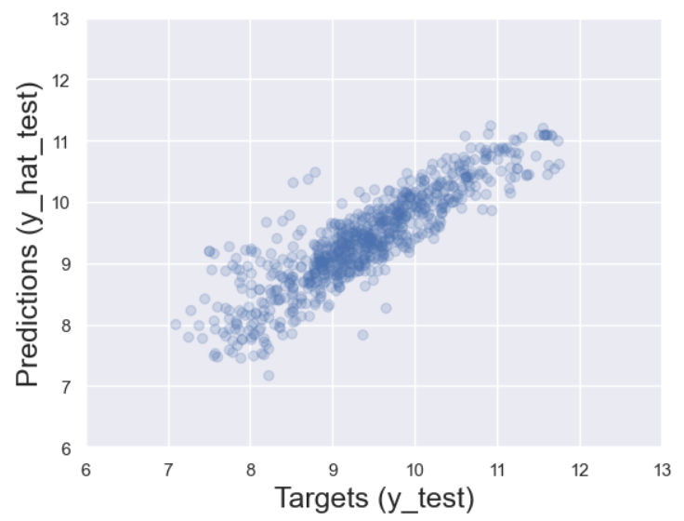
Code:
y_hat_test = reg.predict(x_test)
plt.scatter(y_test, y_hat_test, alpha=0.2)
plt.xlabel('Targets (y_test)',size=18)
plt.ylabel('Predictions (y_hat_test)',size=18)
plt.xlim(6,13)
plt.ylim(6,13)
plt.show()

Slide 37
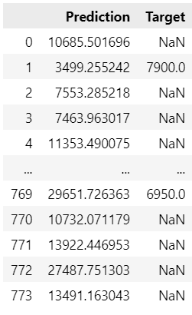
Finally, let's manually check these predictions
To obtain the actual prices, we take the exponential of the log_price
We can also include the test targets in that data frame (so we can manually compare them)
Code:
df_pf['Target'] = np.exp(y_test)
df_pf
Note that we have a lot of missing values.
There is no reason to have ANY missing values, though.
This suggests that something is wrong with the data frame / indexing.

Slide 38
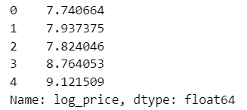
After displaying y_test, we find what the issue is
The old indexes are preserved (recall earlier in that code we made a note on that)
The code was: data_cleaned = data_4.reset_index(drop=True)
Therefore, to get a proper result, we must reset the index and drop the old indexing
Check the result
Code:
y_test = y_test.reset_index(drop=True)
y_test.head()

Slide 39
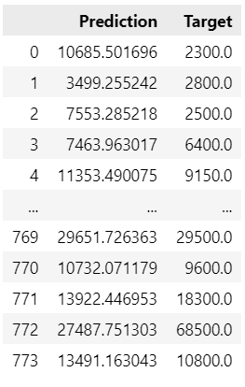
Let's overwrite the 'Target' column with the appropriate values
Again, we need the exponential of the test log price
Code:
df_pf['Target'] = np.exp(y_test)
df_pf

Slide 40
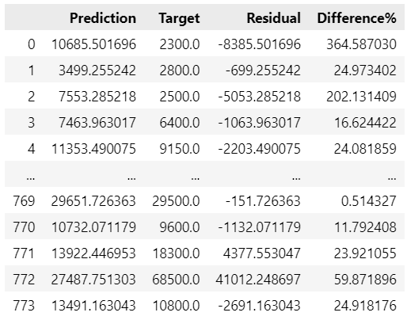
Additionally, we can calculate the difference between the targets and the predictions.
Note that this is actually the residual (we already plotted the residuals).
Since OLS is basically an algorithm which minimizes the total sum of squared errors (residuals).
This comparison makes a lot of sense.
Code:
df_pf['Residual'] = df_pf['Target'] - df_pf['Prediction']
df_pf['Difference%'] = np.absolute(df_pf['Residual']/df_pf['Target']*100)
df_pf

Slide 41
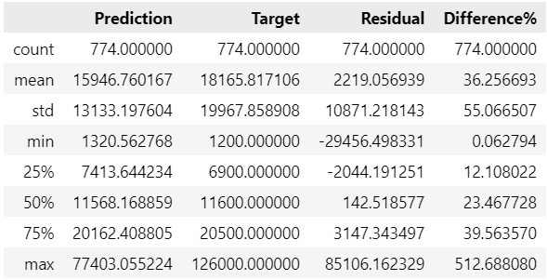
Exploring the descriptives here gives us additional insights
Code:
df_pf.describe()
It is showing max difference percentage as 512.68.
No issues, since majority has desired difference percentage value.

Slide 42
Sometimes it is useful to check these outputs manually
To see all rows, we use the relevant pandas syntax
Code:
pd.options.display.max_rows = 999
Moreover, to make the dataset clear, we can display the result with only 2 digits after the dot
Code:
pd.set_option('display.float_format', lambda x: '%.2f' % x)
Finally, we sort by difference in % and manually check the model
Code:
df_pf.sort_values(by=['Difference%'])

Slide 43
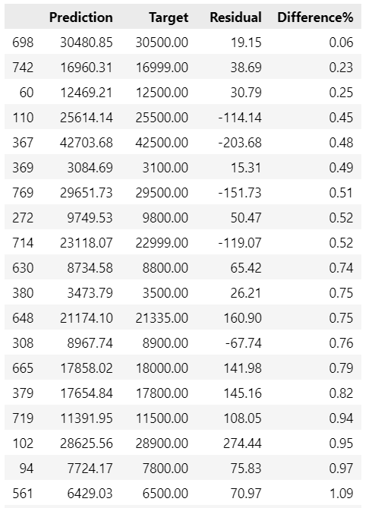
It is not possible to put snapshot of entire table. Since, there are 774 rows.
(Please check jupyter notebook file)

Slide 44
Thank You

